Slide 1

ADAPTIVE ENSEMBLE MACHINE LEARNING FRAMEWORK FOR TIME-SERIES SPECTRUM OCCUPANCY PREDICTION IN COGNITIVE RADIO NETWORKS.
PROJECT MEMBERS
CB.EN.U4ELC24006 | AKSHITA MURALI
CB.EN.U4ELC24014 | DHARSHAVARDHAN UM
CB.EN.U4ELC24031 | S DHEVAN
CB.EN.U4ELC24058 | SUBASHREE A
23ELC212- MACHINE LEARNING
Batch: 2025- 2026 (Even Sem)
Supervised by
Mr. Nakkeeran M
Assistant Professor - EEE
Department of Electrical and Electronics Engineering, Amrita School of Engineering, Coimbatore

Slide 2

Acknowledgement
This work was carried out at Amrita Vishwa Vidyapeetham, Amrita School of Engineering, Coimbatore,for providing us the opportunity and facilities to successfully complete this project.
We express our sincere gratitude to Mr. Nakkeeran M, Assistant Professor, Department of Electrical and Electronics Engineering(EEE), for his valuable guidance, continuous support, and encouragement throughout the course of this project.

Slide 3
Outline
Abstract
Introduction
Background
Problem Statement
Key Contributions of the Project
System Architecture
Proposed Framework
Dataset Details and Related work
Research Approach
Methodology
Machine Learning Techniques
Evaluation Metrics
Implementation Detail
Implementation Tool and Evaluation Metrics
Result Analysis and Discussion
Conclusion and Future Work
References

Slide 4
Abstract
To develop an adaptive ensemble Machine Learning framework for time-series spectrum occupancy prediction in Cognitive Radio Networks (CRNs) to improve dynamic spectrum utilization by allowing secondary users to access unused spectrum without causing interference to primary users.
The proposed system utilizes historical spectrum sensing data to learn temporal patterns of spectrum usage, where the dataset undergoes data preprocessing including cleaning, normalization, and handling of missing values, followed by feature extraction techniques to capture important characteristics of spectrum behavior.
The goal of the proposed system is to accurately predict future spectrum availability, enabling intelligent spectrum access decisions, improving dynamic spectrum management, and enhancing efficient utilization of wireless communication resources in next-generation networks.
Keywords - Cognitive Radio Networks, Spectrum Prediction, Ensemble Learning, Time-Series Analysis, Machine Learning, Dynamic Spectrum Access.

Slide 5
I. Introduction
Rapid growth of wireless communication and cognitive radio technology has increased the demand for efficient spectrum utilization. However, wireless spectrum usage is highly dynamic and influenced by factors such as user behavior, environmental conditions, and network traffic patterns.
Traditional spectrum sensing techniques can detect current channel occupancy but are unable to predict future spectrum availability, which limits efficient spectrum utilization in cognitive radio networks.
Therefore, developing an intelligent prediction mechanism that can analyze historical spectrum data and identify temporal patterns is essential for improving spectrum utilization and communication reliability.

Slide 6
I. Introduction(Contd.,)
In cognitive radio networks, accurate prediction of spectrum availability is a challenging task due to dynamic spectrum usage and complex time-series patterns.
Many existing machine learning approaches rely on single predictive models, which often fail to provide reliable predictions under varying conditions or noisy datasets.
This work aims to develop an adaptive ensemble machine learning framework that combines multiple models to improve prediction accuracy and reliability of spectrum availability.

Slide 7
Problem Statement and Objectives of Spectrum Prediction
Wireless spectrum resources are limited but often underutilized due to static spectrum allocation.
Traditional spectrum sensing methods can only detect current channel occupancy and cannot predict future spectrum availability.
Single machine learning models may not perform well in dynamic spectrum environments.
Therefore, an adaptive ensemble machine learning framework is proposed to improve spectrum occupancy prediction accuracy.

Slide 8
Key Contributions of the Project
The proposed system develops an adaptive ensemble machine learning framework for accurate spectrum occupancy prediction in cognitive radio networks.
Multiple machine learning models are integrated to capture complex temporal patterns and improve the prediction accuracy and reliability.
The system is implemented in a cloud-based environment and evaluated using standard performance metrics to validate the effectiveness of the proposed model.

Slide 9
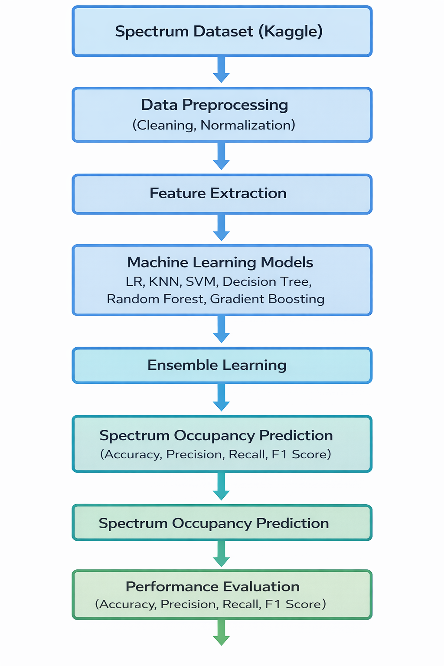
Proposed Framework

Slide 10
II. Data set details & Related Work
Table I. Related Work
Reference Paper | Feature Selection / Extraction | Number of Features Selection (or) Extraction | Machine Learning Classifiers | Accuracy (%) | Pros / Cons of the techniques used in the existing work
M. Yasir, Z. S. Shah, S. A. Memon, and Z. Ali, “Machine learning based analysis of cellular spectrum” [1] | Statistical Feature Analysis | 32 | Support Vector Machine (SVM) | 84.75 | Effective in analyzing cellular spectrum patterns. Provides reliable prediction using machine learning techniques. Performance may decrease in highly dynamic spectrum environments.
T. A. Oyewo, U. S. Dauda, and A. S. Mohammed [9] | Feature Extraction | 34 | Decision Tree | 92.70 | Simple and interpretable model Works well for structured spectrum datasets May suffer from overfitting in complex environments
P. Venkatapathi, H. Khan, S. S. Rao, and G. Immadi [8] | Statistical Feature Extraction | 30 | gradient boosting | 94.60 | Ensemble learning improves prediction accuracy Handles noisy data better than single models Higher computational complexity compared to simple classifiers
This work proposes an adaptive ensemble machine learning framework for spectrum occupancy prediction in cognitive radio networks by integrating multiple machine learning models to improve prediction accuracy, robustness, and reliability compared to existing single-model approaches.

Slide 11
III. Research Approach
Reference Website for Dataset : Kaggle-CASS Spectrum Dataset
This study follows an experimental research approach to develop a machine learning based prediction system for spectrum occupancy.
The problem is formulated as a Binary Classification task, where the model predicts channel status.

Slide 12
IV. Methodology Machine Learning Techniques
Machine Learning Techniques
The proposed system uses several machine learning algorithms to predict spectrum occupancy.
❖ Logistic Regression
❖ K-Nearest Neighbors (KNN)
❖ Support Vector Machine (SVM)
❖ Decision Tree
❖ Random Forest
❖ AdaBoost
❖ Gradient Boosting
❖ Naïve Bayes
These models are trained individually and later combined using an ensemble learning strategy to improve prediction performance.

Slide 13
IV. Methodology - Principal Component Analysis – A Statistical Technique (Contd.,)
Implementation Steps
The proposed system follows these steps:
Import the spectrum dataset
Perform data preprocessing and cleaning
Normalize and transform the dataset
Split the dataset into training and testing sets
Train individual machine learning models
Combine model outputs using ensemble learning
Evaluate the model performance

Slide 14
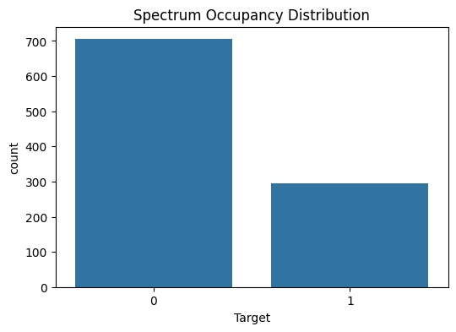
V. Implementation Detail
TABLE V.
Dataset Distribution and Train–Test Split
Dataset Used | Cognitive Radio Spectrum Dataset
Dataset Preparation | normalized dataset
class Types | idle channel(0) | Occupied Channel (1) | Total Records
Training Samples (1) | 1299 | 6701 | 8000
Testing Samples (2) | 325 | 1675 | 2000
No. of records (1+2) | 1624 | 8376 | 10000
Figure 5: Distribution of Free and Occupied Spectrum Channels in the Dataset

Slide 15
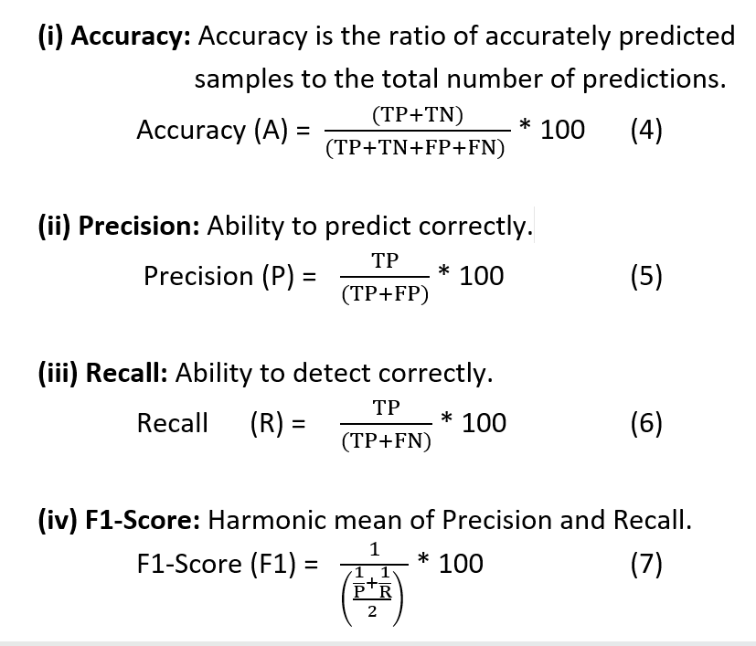
V. Implementation Detail - Implementation Tool and Evaluation Metrics
The performance metrics used for evaluating our proposed model with various ML Classifiers [14]
were accuracy, precision, recall, and F1-score using the confusion matrix [15] shown in Table VI.
TABLE VI. Confusion matrix
No. of testing samples (N records) |  | Predicted Class
 |  | Predicted Free Channel | Predicted Occupied Channel
Actual Class | Free Channel (0) | True Negative (TN) | False Positive (FP)
 | Occupied channel(1) | False Negative (FN) | True Positive (TP)

Slide 16
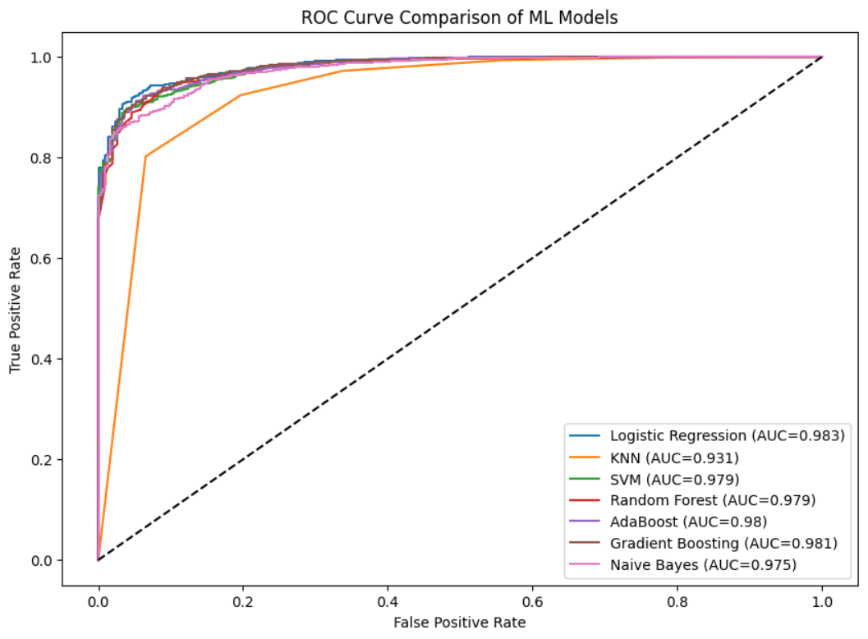
VI. Result Analysis and Discussion
TABLE VII.
Performance Comparison of Machine Learning Models for Spectrum Occupancy Prediction
Machine Learning Model | Training Records | Test Records | Accuracy (%)
Logistic Regression | 8000 | 2000 | 94.95
KNN | 8000 | 2000 | 93.3
SVM | 8000 | 2000 | 94.7
Decision Tree | 8000 | 2000 | 92.7
Random Forest | 8000 | 2000 | 94.45
Gradient Boosting | 8000 | 2000 | 94.6
Naïve Bayes | 8000 | 2000 | 91.35
Figure 6 represents the comparison of accuracy and execution time for different machine learning models used for spectrum occupancy prediction.
Where ‘0’ represents a Free Channel (Idle Spectrum) and ‘1’ represents an Occupied Channel (Primary User Active).

Slide 17
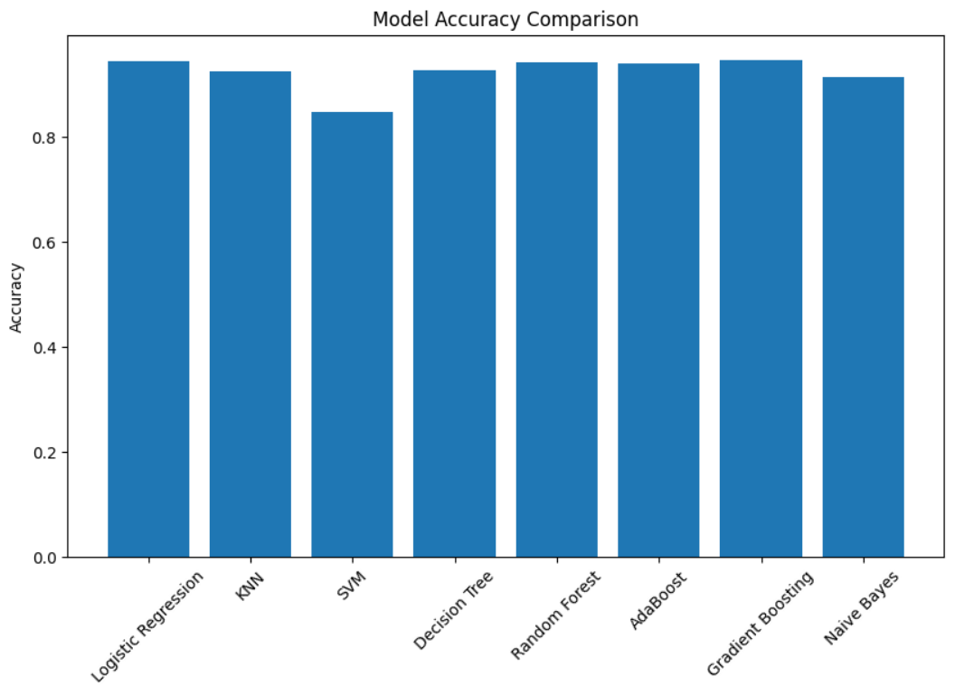
VI. Result Analysis and Discussion
Represents a performance metrics comparison across different machine learning classifiers used for spectrum occupancy prediction.

Slide 18
VI. Result Analysis and Discussion
TABLE VIII.
Accuracy metric comparison of the proposed approach with the existing work
Reference Paper | Feature Selection / Extraction | Number of Features | Machine Learning Classifiers | Accuracy (%) | Pros / Cons
Yasir et al. [1] | Statistical Feature Extraction | 30 | SVM | 93.50 | Good performance for spectrum analysis but sensitive to dynamic spectrum changes. Provides good classification performance for spectrum analysis but its accuracy may decrease in highly dynamic wireless environments.
Keshavamurthy & Michelusi [2] | Spectrum sensing features | 28 | Reinforcement Learning | 92.10 | Learns spectrum access policies but computationally complex. Reinforcement Learning Adapts to changing spectrum conditions effectively but requires higher computational resources and longer training time.
Venkatapathi et al. [8] | Feature Extraction from spectrum sensing data | 32 | gradient boosting | 94.60 | Handles noisy datasets well but requires more computational resources compared to simpler models.
Proposed Work | Data normalization and preprocessing | 18 | Logistic Regression, KNN, SVM, Decision Tree, Random Forest, Gradient Boosting, Naïve Bayes | 94.95 | logistic regression achieved the highest accuracy and improved spectrum prediction performance. Combining multiple machine learning models improves spectrum occupancy prediction accuracy and robustness compared to individual classifiers.

Slide 19
VII. Conclusion and Future Works
Efficient utilization of wireless spectrum is essential for cognitive radio networks, where inaccurate spectrum prediction may lead to poor communication performance and inefficient spectrum usage.
The proposed adaptive ensemble machine learning framework combines multiple models to improve spectrum occupancy prediction accuracy and robustness.
Experimental results show that ensemble learning techniques can effectively analyze historical spectrum data and model temporal spectrum usage patterns.
The proposed system can be extended in future work by exploring deep learning techniques such as Recurrent Neural Networks (RNN) and Long Short-Term Memory (LSTM) for real-time spectrum prediction

Slide 20
References
[1] M. Yasir, Z. S. Shah, S. A. Memon, and Z. Ali, “Machine learning based analysis of cellular spectrum,” International Journal of Wireless and Microwave Technologies, vol. 11, no. 2, pp. 24–31, 2021.
[2] B. Keshavamurthy and N. Michelusi, “Learning-based spectrum sensing and access in cognitive radios via approximate POMDPs,” IEEE Transactions on Cognitive Communications and Networking, 2021.
[3] Y. Zhang and Z. Luo, “A review of research on spectrum sensing based on deep learning,” Electronics, vol. 12, no. 21, 2023.
[4] X. Wen, S. Fang, Z. Xu, and H. Liu, “Joint multidimensional pattern for spectrum prediction using graph neural networks,” Sensors, vol. 23, no. 21, 2023.
[5] T. Kolangiyappan, S. Gauni, and P. Chandhar, “Spectrum occupancy prediction using LSTM models for cognitive radio applications,” Network, 2024.
[6] M. G. Sumithra and M. Suriya, “Improved spectrum prediction model for cognitive radio networks using hybrid deep learning technique,” International Journal of Intelligent Networks, vol. 5, pp. 286–292, 2024.
[7] S. Mondal, M. P. Dutta, and S. K. Chakraborty, “A hybrid deep learning model for efficient spectrum sensing in cognitive radio,” Journal of Electrical Systems, vol. 20, no. 3, 2024.
[8] P. Venkatapathi, H. Khan, S. S. Rao, and G. Immadi, “Cooperative spectrum sensing performance assessment using machine learning in cognitive radio sensor networks,” Engineering, Technology & Applied Science Research, vol. 14, no. 1, 2024.

Slide 21
References
[9] T. A. Oyewo, U. S. Dauda, and A. S. Mohammed, “Spectrum occupancy prediction using a modified XGBoost machine learning algorithm,” International Conference on Scientific and Academic Research, 2023.
[10] G. Pan, D. K. Y. Yau, B. Zhou, and Q. Wu, “Deep learning for spectrum prediction in cognitive radio networks: State-of-the-art and future challenges,” 2024.
[11]S. Haykin, “Cognitive radio: Brain-empowered wireless communications,” IEEE Journal on Selected Areas in Communications.
[12]T. Yucek and H. Arslan, “A survey of spectrum sensing algorithms for cognitive radio applications,” IEEE Communications Surveys & Tutorials.
[13]Y. Zeng, Y. Liang, A. Hoang, and R. Zhang, “A review on spectrum sensing for cognitive radio,” IEEE Communications Surveys & Tutorials.
[14]I. F. Akyildiz, W. Y. Lee, M. C. Vuran, and S. Mohanty, “Next generation dynamic spectrum access cognitive radio networks,” Computer Networks.

Slide 22
THANK YOU

